Slide 1
HR Analytics: Job Change of Data Scientists
Team 8: Aash Gohil, Caroline Guo, Caroline Lun, Chris Chang, Jacinto Lemarroy

Slide 2
TABLE OF CONTENTS
01
02
Intro to Problem
EDA
03
04
ML Models
Conclusion
Background and Objective + Dataset Summary
Analysis of correlation among variables
Comparison of ML models to see which performed best
Results + Suggestions to HR department for candidate selection

Slide 3
01
Intro to Problem
Background and Objective
Dataset Summary

Slide 4
Overview
Background
Bigger Picture?
Objective
Company active in data science wants to hire people who received training.
Company wants to analyze factors affecting a candidate's decision on staying or looking for a new job after training.
To optimize HR costs and increase efficiencies.
To analyze and predict whether a data scientist candidate will look for a new employment or wants to work for the company after training.

Slide 5
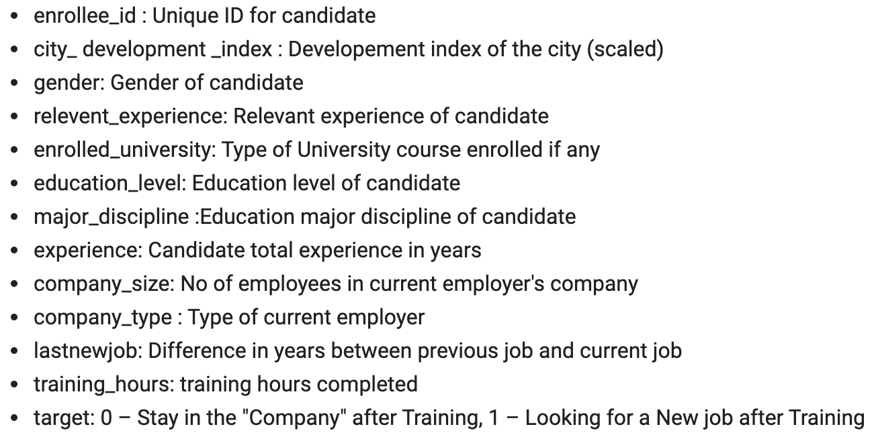
Dataset Summary
Overview
12,477 rows and 13 features
Notes:
We kept unknowns only for company size and type

Slide 6
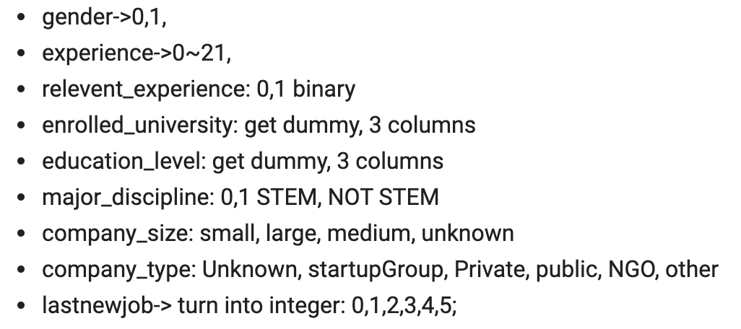
Dataset Processing
Data Preparation for ML
Data Cleaning for EDA
Created dummy variables and categorized groups within features
Assigned ‘Unknown’ to null values then dropped nulls that didn’t make much impact in each feature - only kept unknowns in company size and type.
Notes:
We kept unknowns only for company size and type

Slide 7
02
Exploratory Data Analysis
2.1. Demographics
2.1.1. Gender
2.1.2. City
2.1.3. Education
2.1.4. Job History
2.2. Engagement and Retention

Slide 8
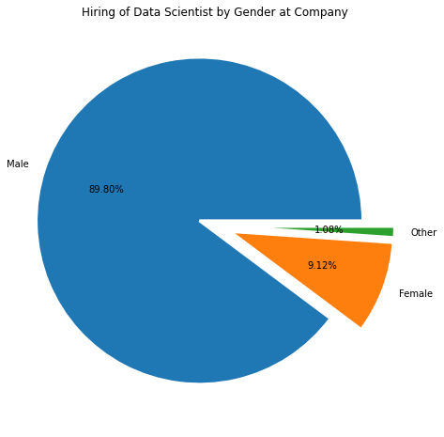
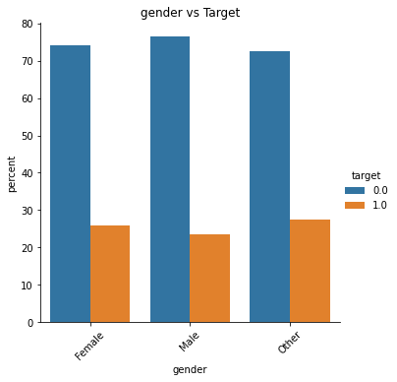
Gender
Is the hiring of data scientists gender biased?
What is the impact of gender on attrition?
Notes:
Approximately 90% of the hires are male, demonstrating a bias in the hiring of DS at this company. This is an interesting figure given that according to zippia.com, The industry average of male DS in USA is 65%. And from the graph on the right we see gender having no impact on attrition.

Slide 9
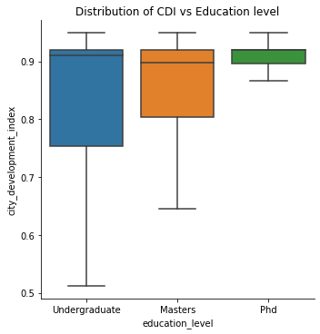
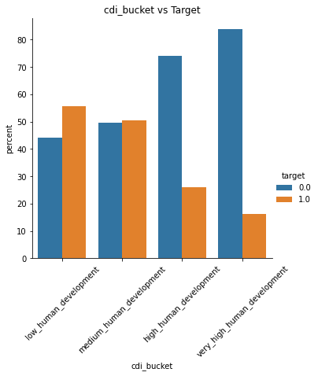
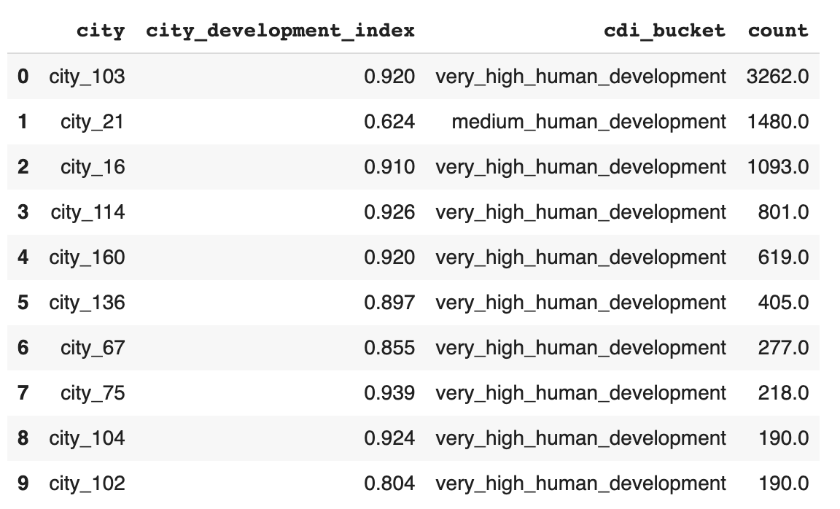
City
Top 10 cities the company hires from and their corresponding CDI
How is CDI correlated with an individual’s education level?
Notes:
CDI is ranked on a scale from 0 to 1.0, with 1.0 being the highest human development. HDI is broken down into four tiers: very high human development (0.8-1.0), high human development (0.7-0.79), medium human development (0.55-.70), and low human development (below 0.55).
Company hires mainly from very high human development cities, with majority of the candidates coming from city_103. The only exception is city_21 which is the 2nd highest in terms of hiring but has medium CDI, it can be possible this is a University Town.
In general, the candidates with higher qualifications belong to cities with higher CDI.
Candidates from cities with lower and medium development index are more likely to look for a change.

Slide 10
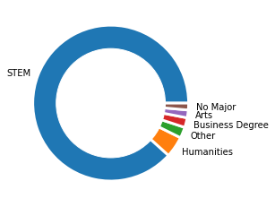
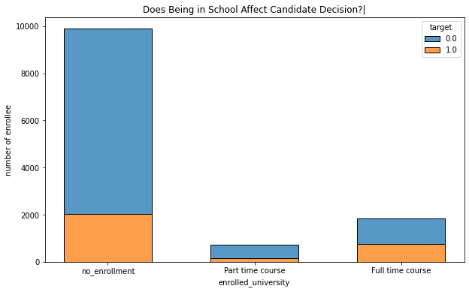
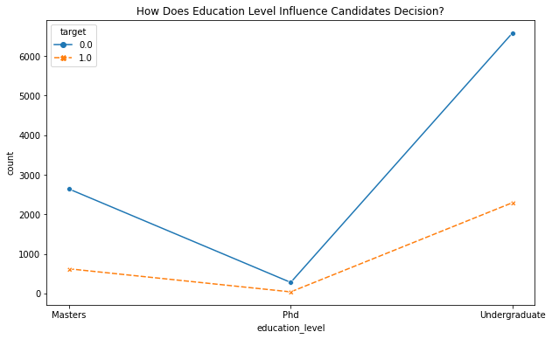
Education
What are some education characteristics for those candidates who are staying?
Notes:
Most of the enrollees major in STEM, which is reasonable because the company is hiring data scientists
Candidates who have no enrollment or enroll in part-time course tend to stay in the company.
Tells us a little about the seniority of the role, probably not entry-level position, most likely something higher up in the company
This is important to point out given that most Data scientist roles require specific backgrounds and more years of experience
Most candidates have undergraduate education background, and small portion of the candidates has Phd.

Slide 11
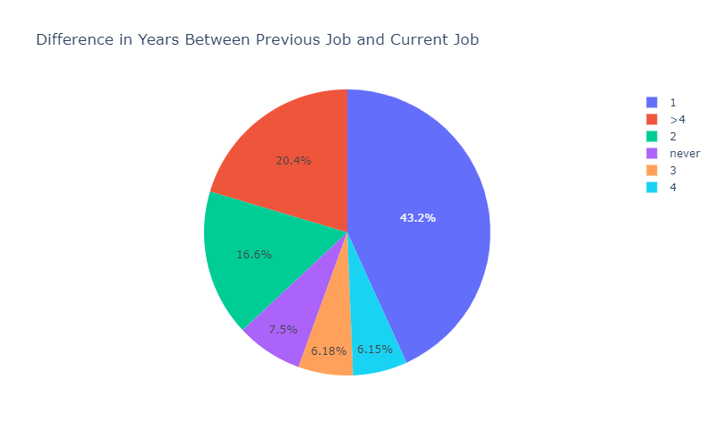
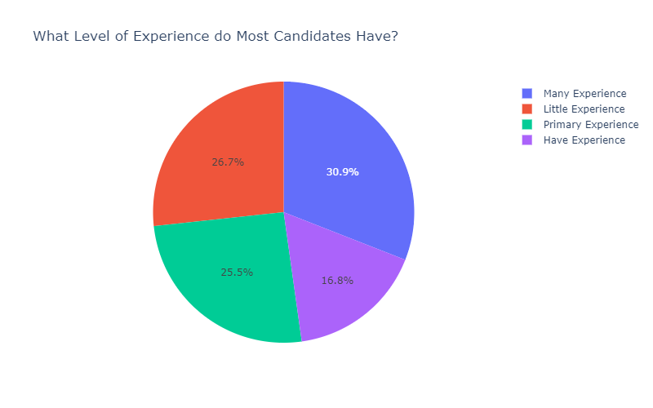
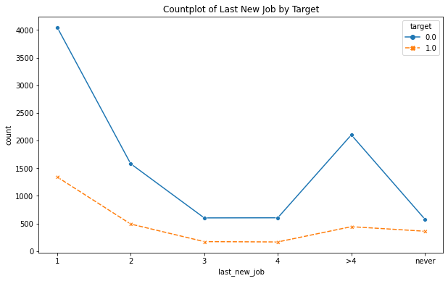
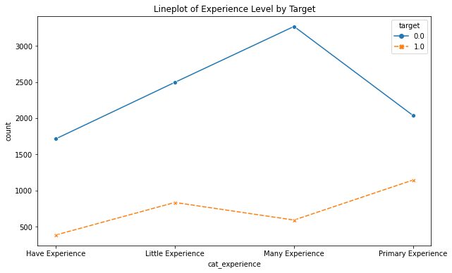
Gap Years/Relevant Experience
Last New Job: Difference in years between previous job and current job
Stay
Stay
< 1 : 4
1 : 3
1 : 4
Notes:
According to the above plot, we can easily tell that when the gap year(s) between last and new is(are) 1 or 2, the ratio between leave and stay is 1:3. When the gap duration increases to 3, 4 or even more than 4, the ratio of leave and stay decreases to 1:4. This means if the last job and new job gap turns longer, more candidates tend to stay in this Big Data company correspondingly.
However, when we come to candidates never change their job -- the 'never' group, we can see that the ratio between leave and stay are 1:2, which means least candidates in this group will stay in this company rather than their original ones.
This will give HR a hint: When recruiting candidates to join this program, we can turn to candidates with longer gap beween last job and new one. However, not the ones who never change their job, those may experience nostalgia and don't want any change.

Slide 12
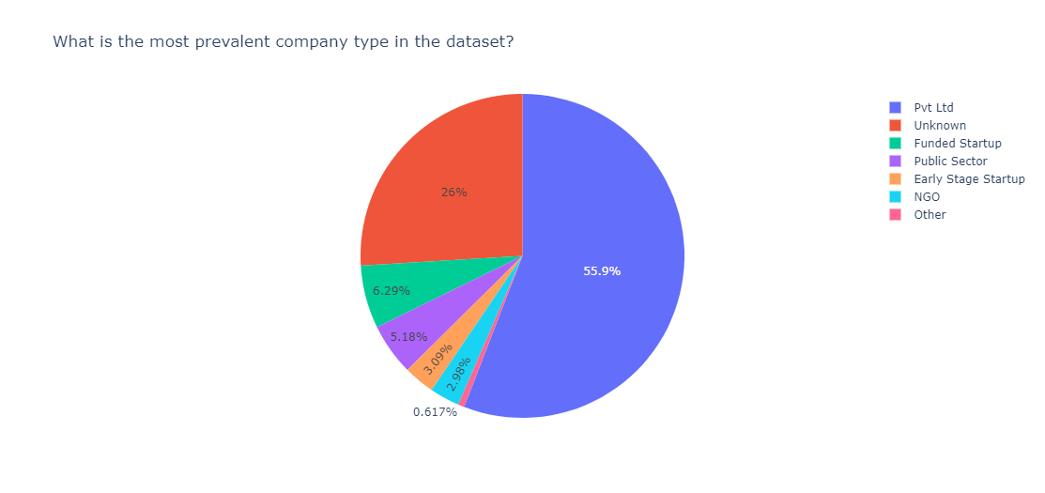
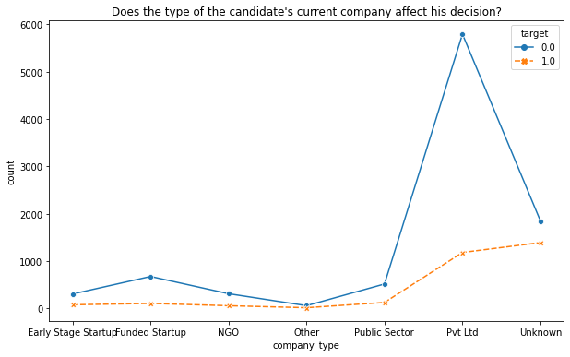
Company Type
Most candidates from Private Company seems like to stay after training
56% of Candidates from Private Company
Notes:
It seems like candidates from private companies tend to stay with the "company" after training. However, 75% of the candidates come from private companies. We need to further investigate into why most data scientist candidates come from a private company. Is there a reason? Perhaps "company" should focus its efforts into targeting only that company type. We could isolate those who come from pvt ltd.

Slide 13
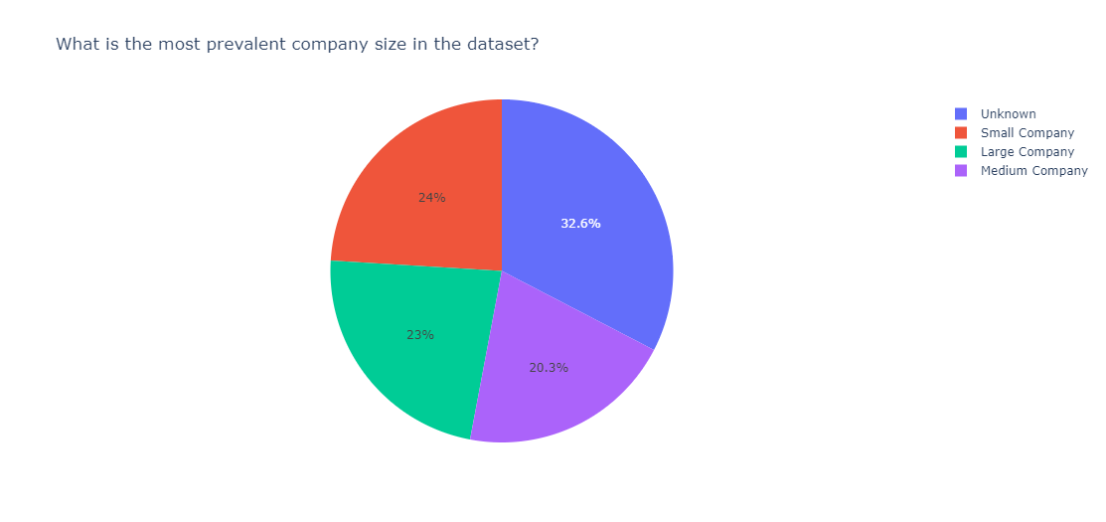
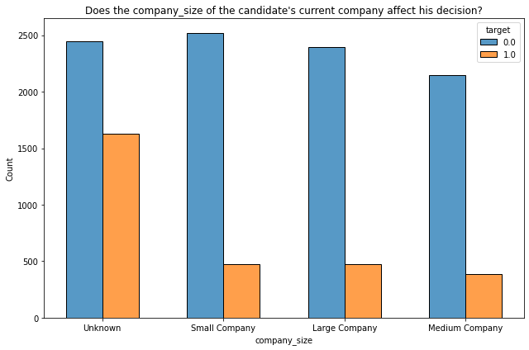
Company Size
Candidates coming from small companies tend to stay with the "company" after training
Candidates come from different size companies.
Notes:
When comparing the sizes of the candidates' current companies, the candidates coming from small companies tend to stay with the "company" the most. However, there is not a clear relationship between the company size and the candidate's decision to stay after training.

Slide 14
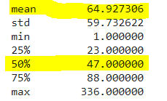
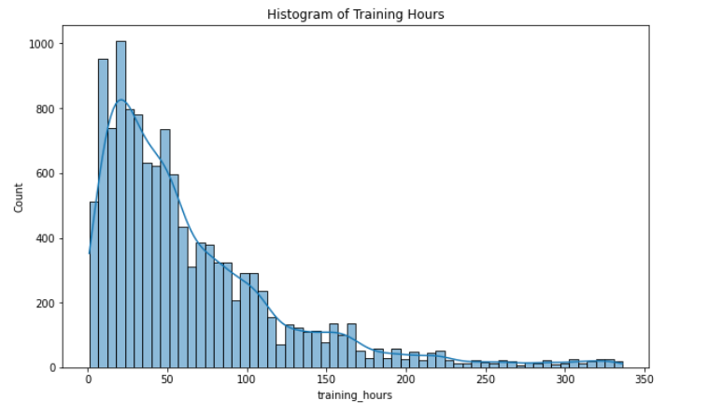
Training and Retention
Training Hours:
How much training hours does the company invest in its future employees?

Slide 15
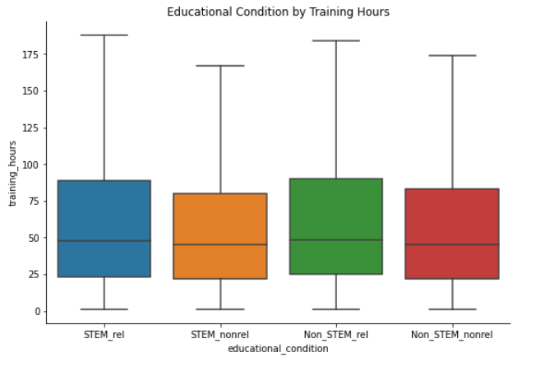
Training and Retention
Training Hours:
Is training dependant on candidates past background?

Slide 16
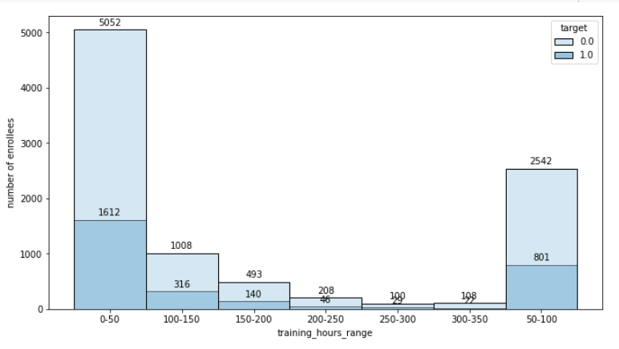
Training and Retention
Does training hours impact retention?

Slide 17
03
Machine Learning
Models & Results
Gaussian Naive Bayes
Logistic Regression
Random Forest
XGBoost
Multilayer Perceptron Classifier

Slide 18
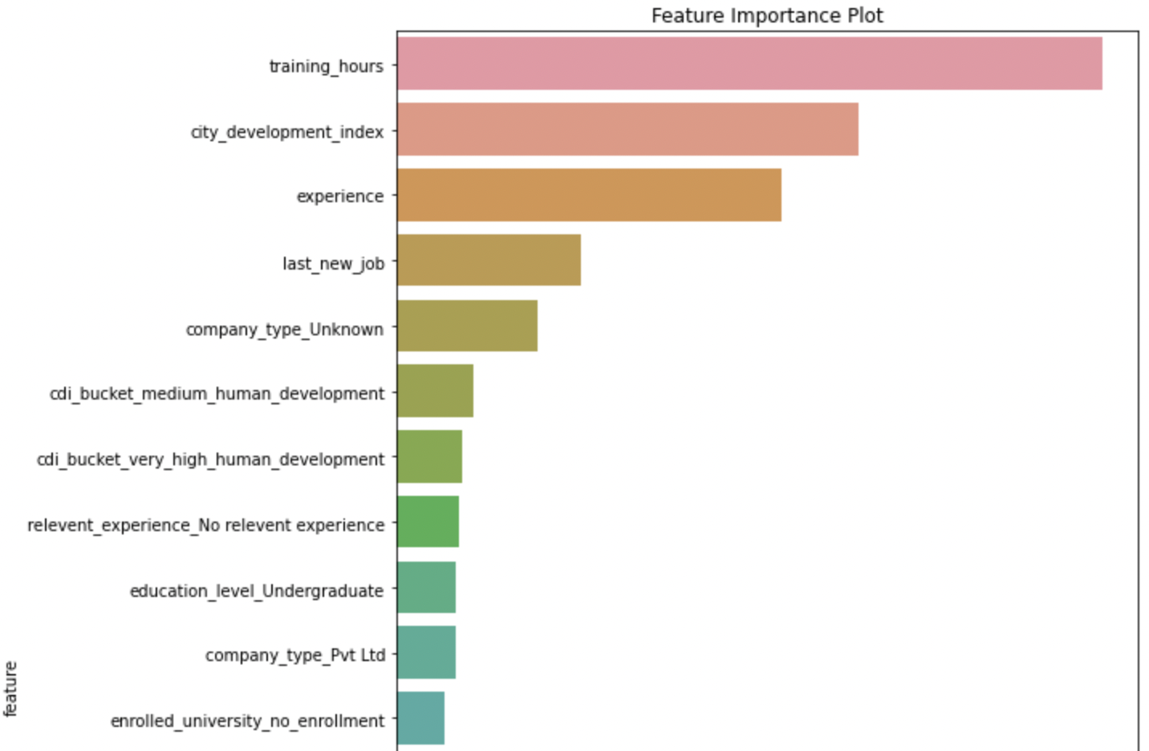
Main Results of ML Models: Feature Engineering

Slide 19
Main Results of ML Models
 | Accuracy | Sensitivity | Specificity | AUC
Gaussian Naive Bayes | 0.7476 | 0.8201 | 0.5759 | 0.75
Logistic Regression | 0.7769 | 0.1956 | 0.9527 | 0.78
Random Forest | 0.7891 | 0.4154 | 0.8880 | 0.7681
XGBoost | 0.8037 | 0.4833 | 0.9005 | 0.69
Multilayer Perceptron Classifier | 0.88 | 0.8333 | 0.9231 | 0.78

Slide 20
04
Conclusion
Main Results Overall
Recommendation for HR hiring

Slide 21
Main Results & Advices For HR
For the Exploratory Data Analysis:
Demographics
No gender bias.
Candidates with higher “quality” come from cities with higher CDI.
STEM majored candidates have higher chance to stay.
With gap between last and new job increases, possibility of stay goes up as well.
Notes:
For the EDA part, first level was demographic.
No gender bias, higher quality candidates come from higher CDI
STEM majored tend to stay
Gap between last and new job increases, possibility of stay goes up.
Hint: Choose whatever quality HRs pay attention to.
And NEXT...

Slide 22
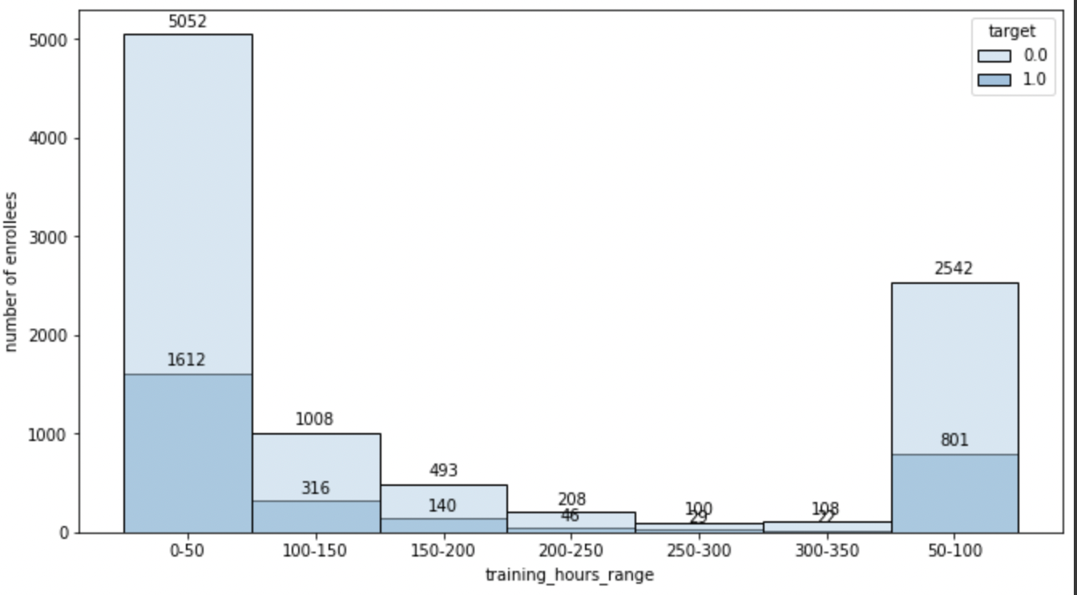
Main Results & Advices For HR
For the Exploratory Data Analysis:
B. Engagement and Retention
Ideal range of training hours: 50-150 hours training range has higher percentage of retention about 76%.
STEM major or not, has relevant experience or not do not impact training hours.
Notes:
Second level was engagement and retention level.
To start with, the ideal range of training hour is 50-150, which shares a 76% retention.
Moving forward...

Slide 23
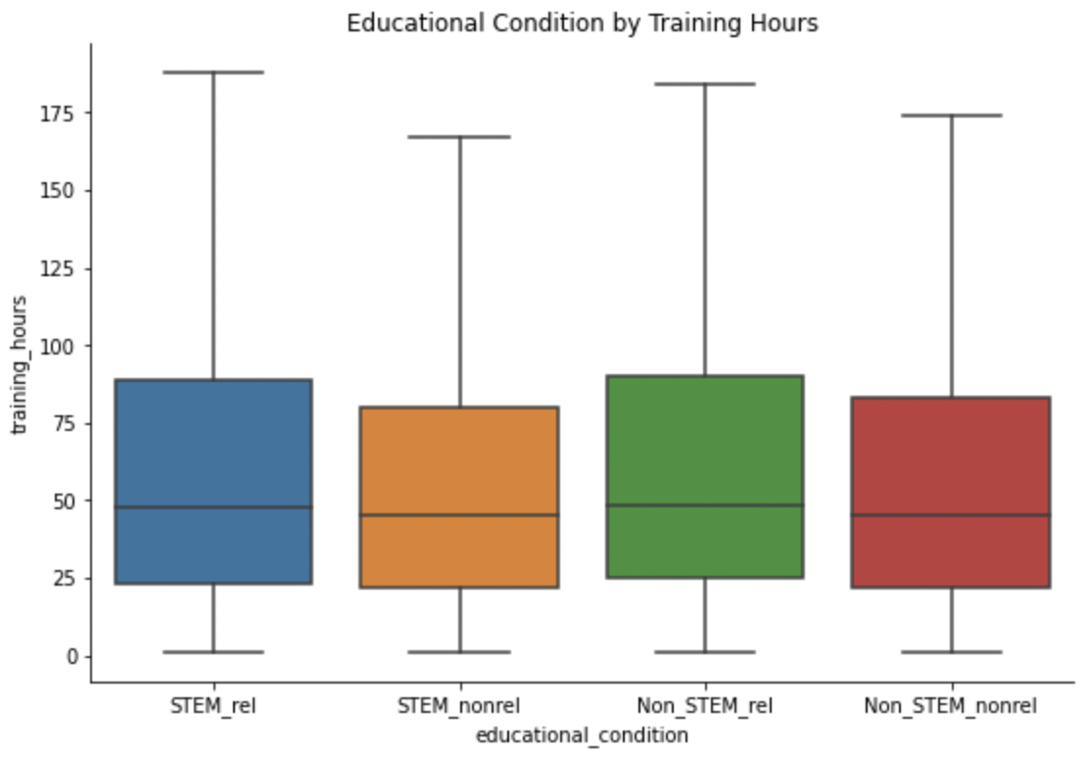
Main Results & Advices For HR
For the Exploratory Data Analysis:
B. Engagement and Retention
Ideal range of training hours: 50-150 hours training range has higher percentage of retention about 76%.
STEM major or not, has relevant experience or not do not impact training hours.
Notes:
Second, the boxes tell us STEM & experienced or not do not impact training hours.
HRs can open up more opportunities for candidates with various backgrounds.

Slide 24
Main Results & Advices For HR
For the Machine Learning Model:
Logistic and MLP has the best performance, with AUC score of 0.78.
Training hours, city development and candidates’ year of experience play a vital role in predicting whether the candidates stay or not after training.
Notes:
Last, for ML Models,
Obviously, logistic and MLP performed best.
Training hrs, CDI and

Slide 25
Thanks!
Does anyone has any questions?

Slide 26
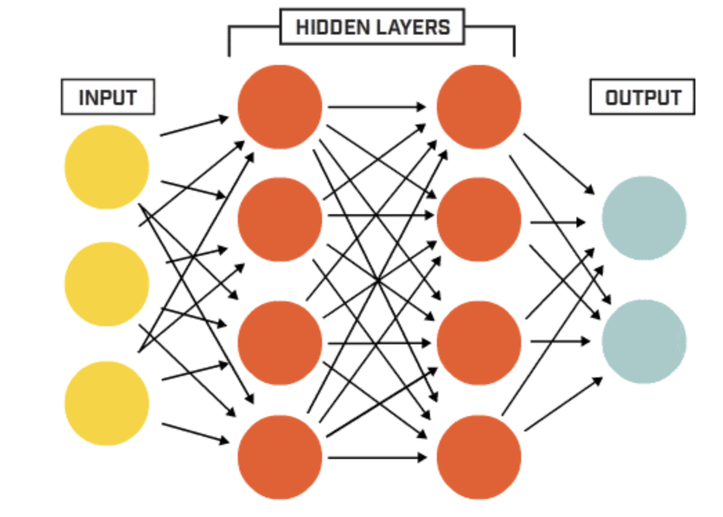
Multilayer Perceptron Classifier: An artificial neural network with a forward structure.

